Slide 1

Panama Papers Analysis through Graph Analytics and Embeddings
Manos Chatzakis, Eva Chamilaki
Presentation for the course cs484 – Complex Networks Dynamics

Slide 2
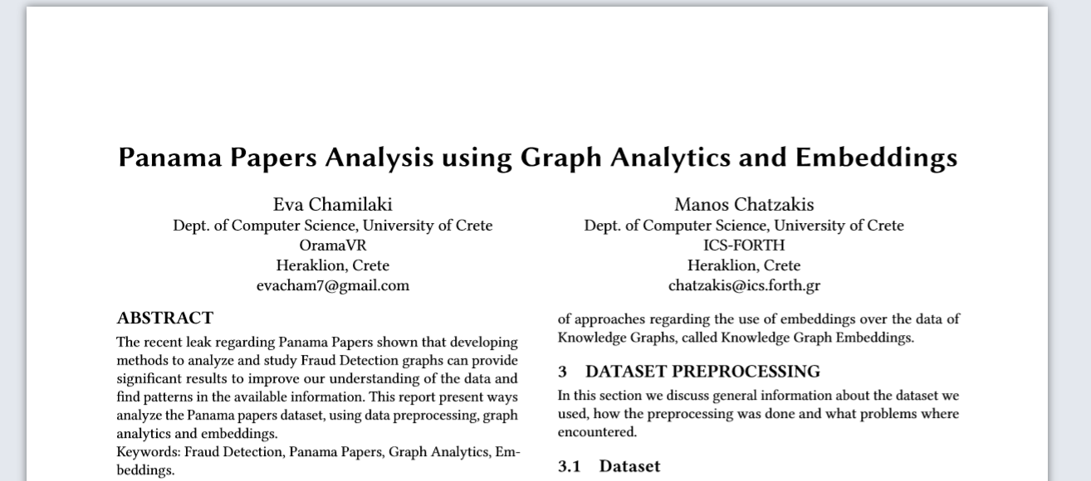
General
This presentation is a briefing of the original report of the analysis, available at our GitHub repository

Slide 3
Roadmap
Introduction
Background (~1min)
Dataset Preprocessing (~1min)
Graph Analytics
Base Dataset Analysis
Algorithms
Visualizations
Graph Embeddings
Embeddings production algorithms
RDFsim implementation
Conclusion

Slide 4
Background

Slide 5

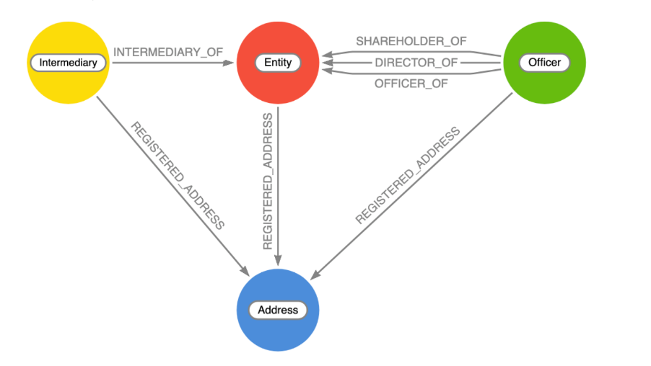
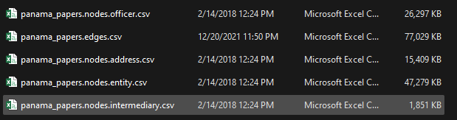
What are Panama Papers?
Documents Exposing the financial activity of over 200.00 offshore and other companies
And the relations between clients and other entities
Made public in 2016.
Embeddings: Vector representations of the data using pretrained neural networks
The public dataset of panama papers can be represented as a network of specific type of nodes and edges
This is a kind of fraud detection graph, in which we can do analysis and discover new information about the dataset!
Graph Analytics: Pre-implemented methods and algorithms to analyze the data

Slide 6
Dataset Preprocessing

Slide 7
Dataset Preprocessing
General: The dataset contains too much information about the

Slide 8
Graph Analytics

Slide 9
Base Dataset Analysis

Slide 10
Algorithms and Visualizations

Slide 11
Embeddings

Slide 12
General

Slide 13
Implementation

Slide 14
Use Cases and Examples

Slide 15
Conclusion

